Slide 1
Azure Functions

Slide 2
Introduction
Azure Functions is a solution for easily running small pieces of code, or "functions," in the cloud.
You can write just the code you need for the problem at hand, without worrying about a whole application or the infrastructure to run it.
Functions can make development even more productive, and you can use your development language of choice, such as C#, F#, Node.js, Java, or PHP.
Pay only for the time your code runs and trust Azure to scale as needed.
Azure Functions lets you develop serverless applications on Microsoft Azure, without having to first create a VM or publish a web application.

Slide 3
Features
Choice of language - Write functions using your choice of C#, F#, or Javascript.
Pay-per-use pricing model - Pay only for the time spent running your code.
Bring your own dependencies - Functions supports NuGet and NPM, so you can use your favorite libraries.
Integrated security - Protect HTTP-triggered functions with OAuth providers such as Azure Active Directory, Facebook, Google, Twitter, and Microsoft Account.
Simplified integration - Easily leverage Azure services and software-as-a-service (SaaS) offerings.
Flexible development - Code your functions right in the portal or set up continuous integration and deploy your code through GitHub, Visual Studio Team Services, and other supported development tools.
Open-source - The Functions runtime is open-source and available on GitHub.

Slide 4
Use of Azure functions
Functions is a great solution for processing data, integrating systems, working with the internet-of-things (IoT), and building simple APIs and microservices.
Consider Functions for tasks like image or order processing, file maintenance, or for any tasks that you want to run on a schedule.

Slide 5
Templates
HTTPTrigger - Trigger the execution of your code by using an HTTP request. For an example, see Create your first function.
TimerTrigger - Execute cleanup or other batch tasks on a predefined schedule. For an example, see Create a function triggered by a timer.
GitHub webhook - Respond to events that occur in your GitHub repositories. For an example, see Create a function triggered by a GitHub webhook.
Generic webhook - Process webhook HTTP requests from any service that supports webhooks. For an example, see Create a function triggered by a generic webhook.
CosmosDBTrigger - Process Azure Cosmos DB documents when they are added or updated in collections in a NoSQL database. For an example, see Create a function triggered by Azure Cosmos DB.
BlobTrigger - Process Azure Storage blobs when they are added to containers. You might use this function for image resizing. For more information, see Blob storage bindings.
QueueTrigger - Respond to messages as they arrive in an Azure Storage queue. For an example, see Create a function triggered by Azure Queue storage.

Slide 6
EventHubTrigger - Respond to events delivered to an Azure Event Hub. Particularly useful in application instrumentation, user experience or workflow processing, and Internet of Things (IoT) scenarios. For more information, see Event Hubs bindings.
ServiceBusQueueTrigger - Connect your code to other Azure services or on-premises services by listening to message queues. For more information, see Service Bus bindings.
ServiceBusTopicTrigger - Connect your code to other Azure services or on-premises services by subscribing to topics. For more information, see Service Bus bindings.

Slide 7
Integrations
Azure Functions integrates with various Azure and 3rd-party services. These services can trigger your function and start execution, or they can serve as input and output for your code. The following service integrations are supported by Azure Functions:
Azure Cosmos DB
Azure Event Hubs
Azure Event Grid
Azure Mobile Apps (tables)
Azure Notification Hubs
Azure Service Bus (queues and topics)
Azure Storage (blob, queues, and tables)
GitHub (webhooks)
On-premises (using Service Bus)
Twilio (SMS messages)

Slide 8
Cost of Azure Functions
Azure Functions has two kinds of pricing plans.
Consumption plan - When your function runs, Azure provides all of the necessary computational resources. You don't have to worry about resource management, and you only pay for the time that your code runs.
App Service plan - Run your functions just like your web, mobile, and API apps. When you are already using App Service for your other applications, you can run your functions on the same plan at no additional cost.

Slide 9
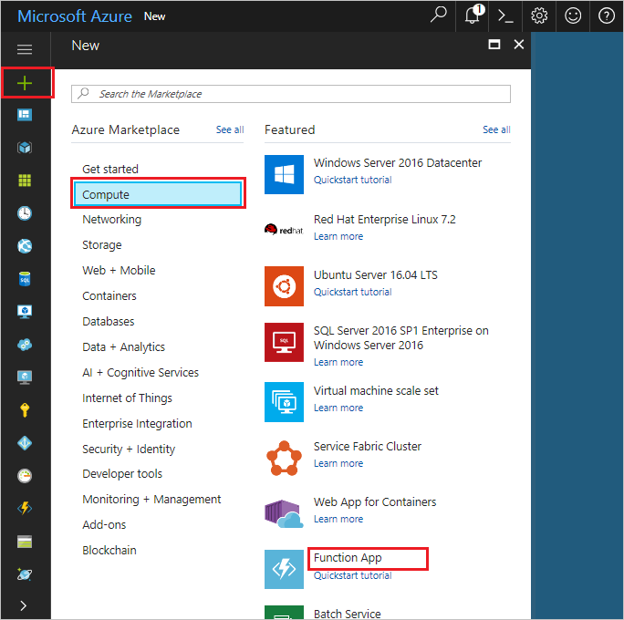
Lab: Creating a function app
Click the New button found on the upper left-hand corner of the Azure portal, then select Compute > Function App

Slide 10
Use the function app settings as specified below.
Setting | Suggested value
App name | Globally unique name
Subscription | Your subscription
Resource Group | myResourceGroup
OS | Windows
Hosting plan | Consumption plan
Location | West Europe
Storage account | Globally unique name

Slide 11
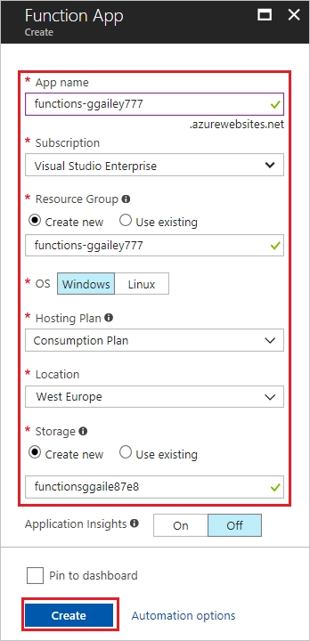
Click create to provision the app.

Slide 12
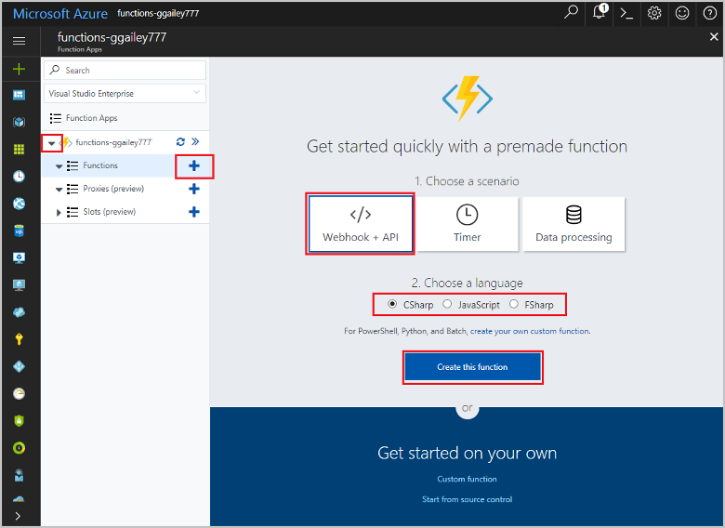
Creating a HTTP-Triggered function
Expand your new function app, then click the + button next to Functions.
In the Get started quickly page, select WebHook + API, Choose a language for your function, and click Create this function.

Slide 13
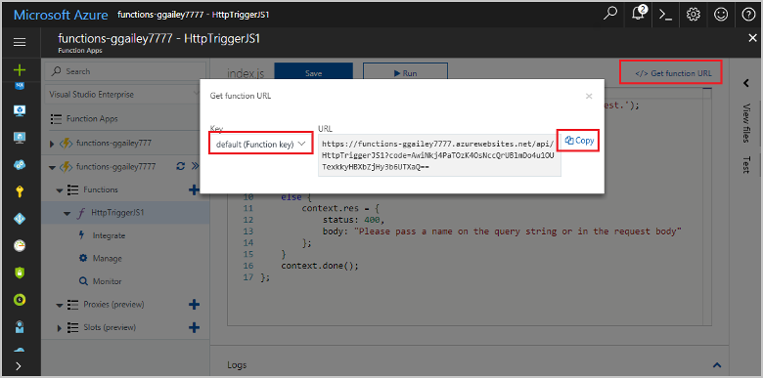
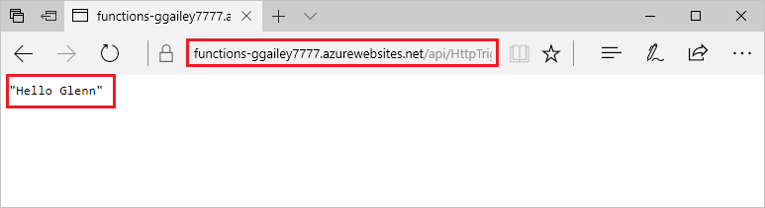
Test the function
In your new function, click </> Get function URL, select default (Function key), and then click Copy.
Copy the function URL from the Azure portal
Paste the function URL into your browser's address bar. Append the query string &name=<yourname> to this URL and submit the request. The request URL includes a key that is required, by default, to access your function over HTTP.

Slide 14
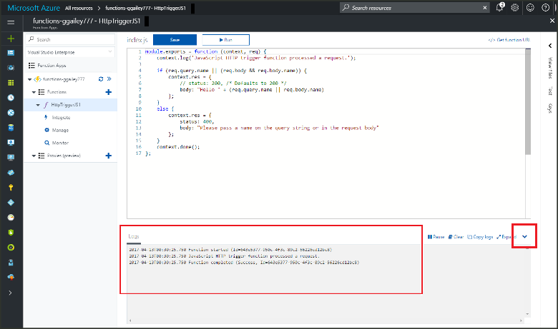
When your function runs, trace information is written to the logs.
To see the trace output from the previous execution, return to your function in the portal and click the up arrow at the bottom of the screen to expand Logs.

Slide 15
Lab: Creating an Azure Function in Visual Studio

Slide 16
Thank you
Technical Learning Services

